Slide 1
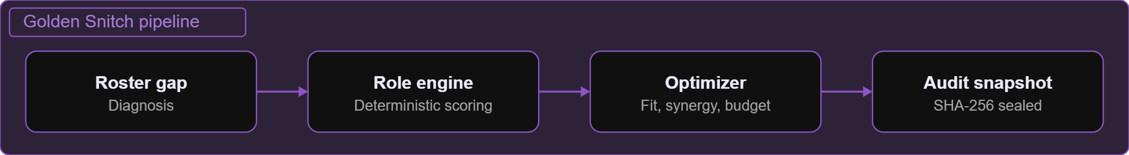
Golden Snitch (ScoutIQ)
Triwizathon · Problem Statement 4 · Team Logic Legend
Roster-first esports scouting and multi-roster intelligence for VALORANT and CS2

Slide 2
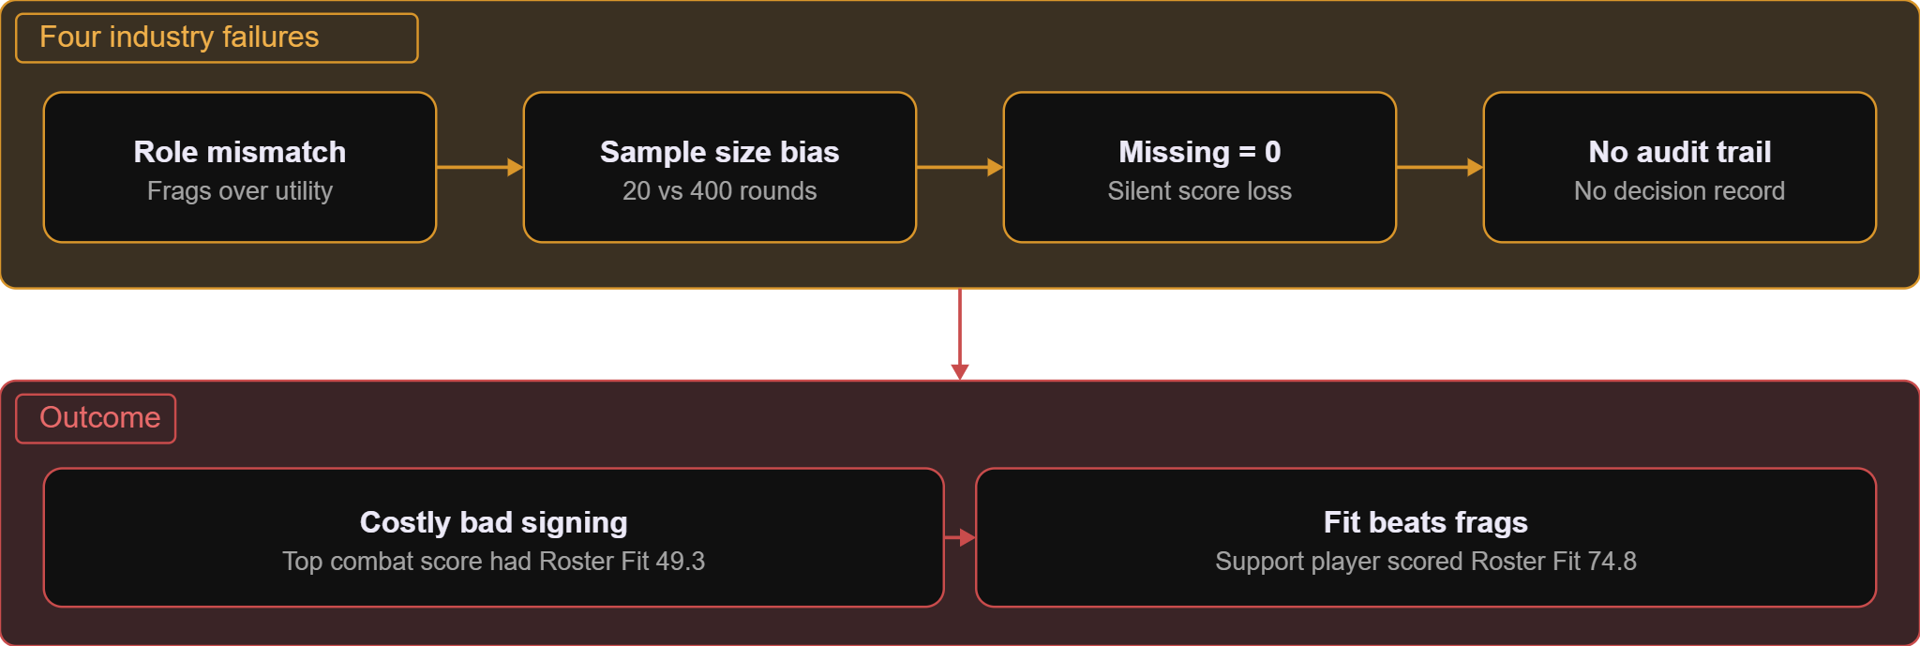
Why esports scouting breaks
Four failures lead to an expensive signing
Evidence: 49.3 vs 74.8 roster-fit anomaly

Slide 3
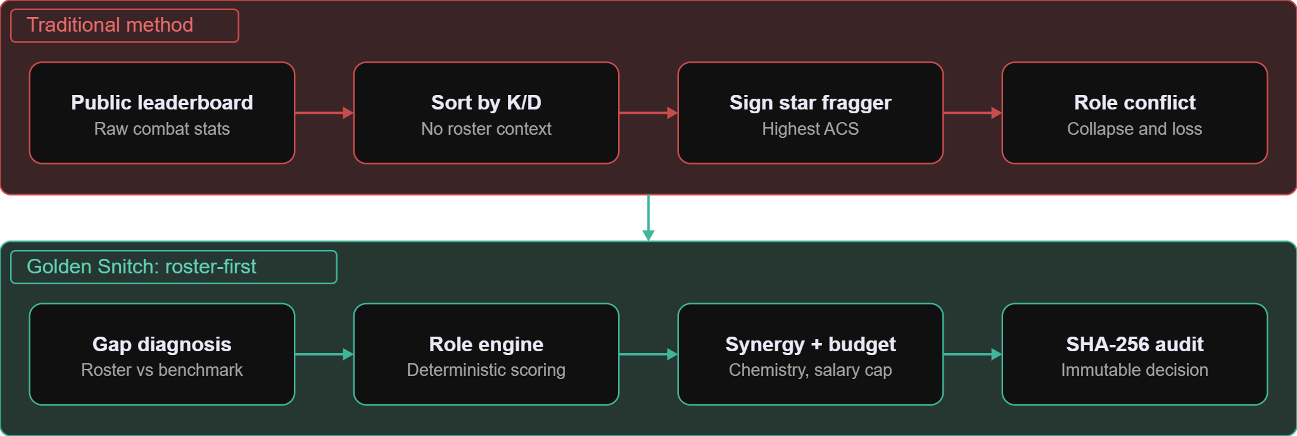
Roster-first scouting
From "who has the best stats?" to "who fixes our weakness?"
Deterministic scoring · analyst-certified IGL guardrail · immutable decisions

Slide 4
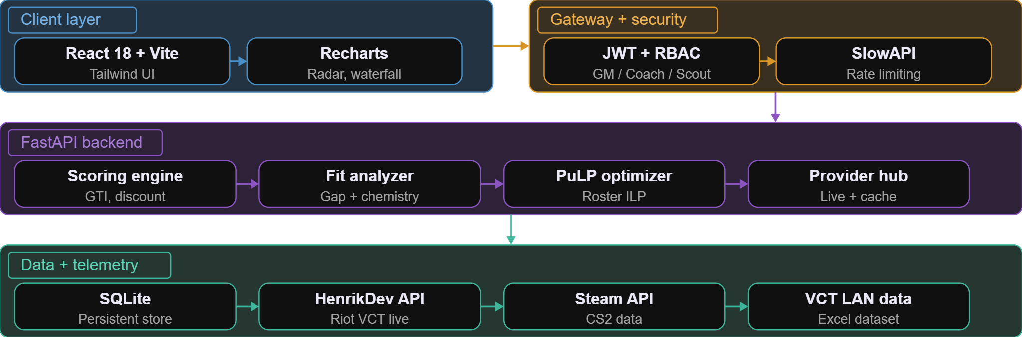
System architecture
Async FastAPI backend behind a secured, role-aware gateway
Python 3.12 · FastAPI · Pydantic v2 · React 18 · SQLite

Slide 5
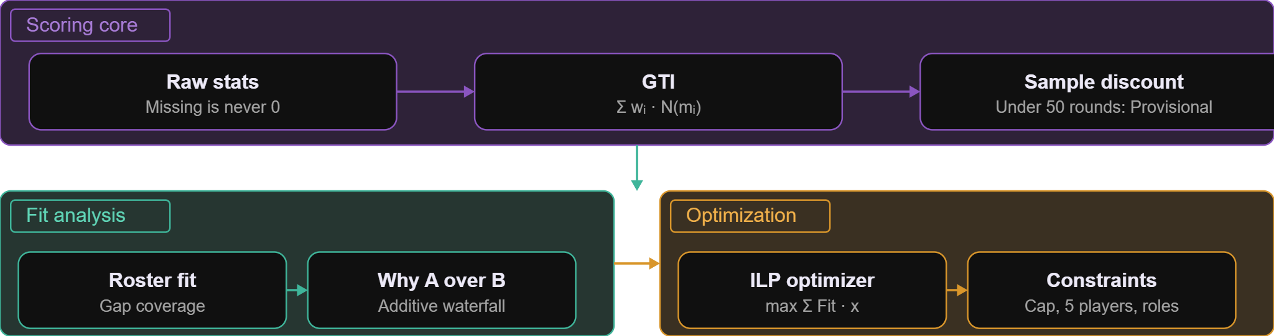
Mathematical engine
A deterministic pipeline from raw stats to the optimal roster
GTI = Global Talent Index · ILP = integer linear programming

Slide 6
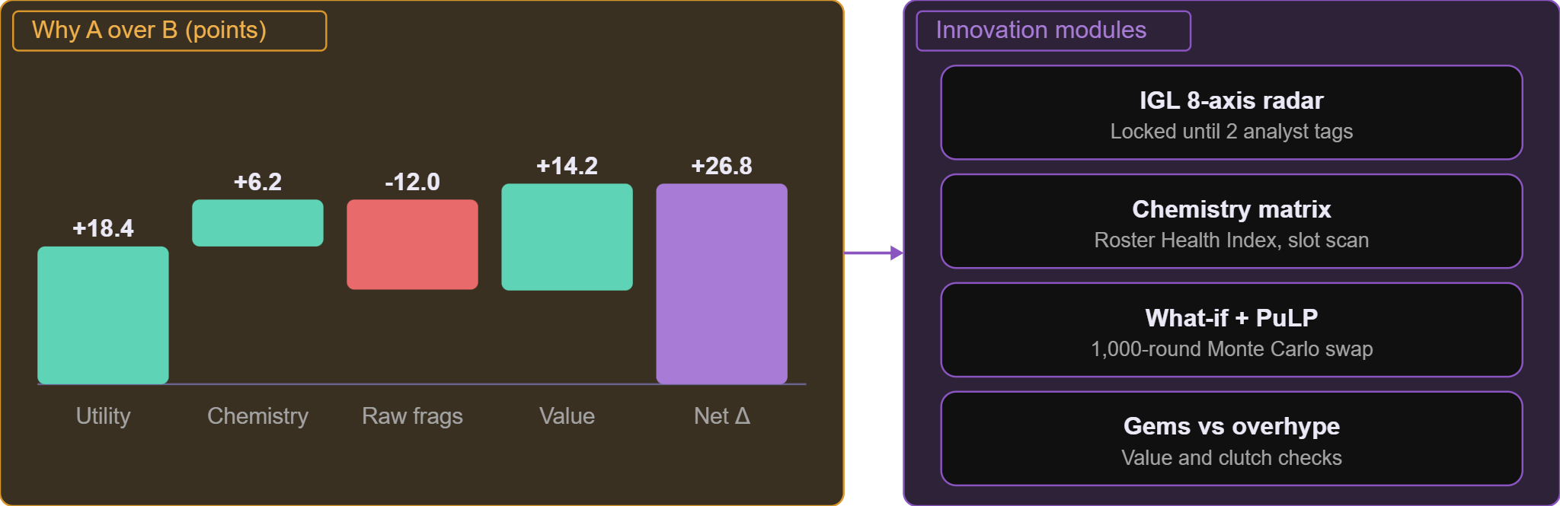
Five core innovations
The waterfall sums exactly to the decision delta
Waterfall values: example from the project report; net is the sum of the four parts

Slide 7
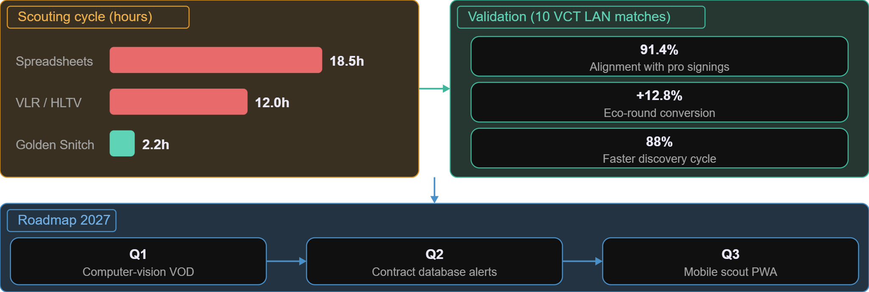
Validation, impact and roadmap
Results from 10 VCT LAN matches, and the next three quarters
Figures as stated in the project report

